Slide 1
Visual Studio (VS) Installer
Open VS Installer and click “Modify” in front of VS Community 2017

Slide 2
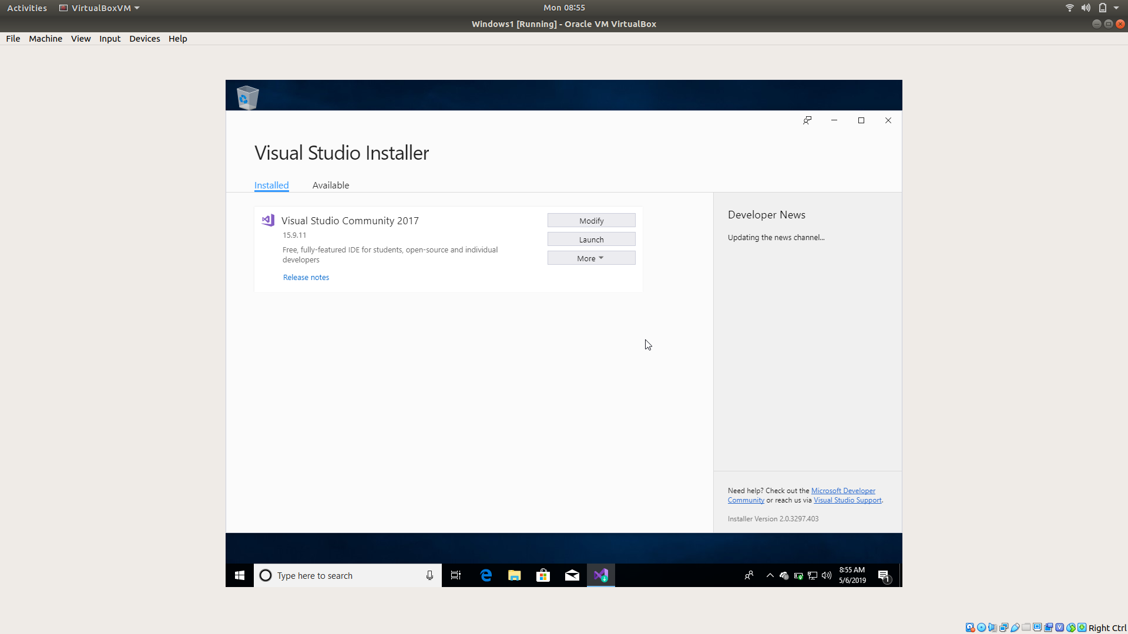

Slide 3
Install VS Components
Goto Individual Components
Select the list of components (shown in right)
There will be many VS 2017 options. Selecting anyone will do the job
Download Windows 10 SDK & Windows CRT SDK
This 3 (#3 & #4) above packages should automatically select rest of the components

Slide 4
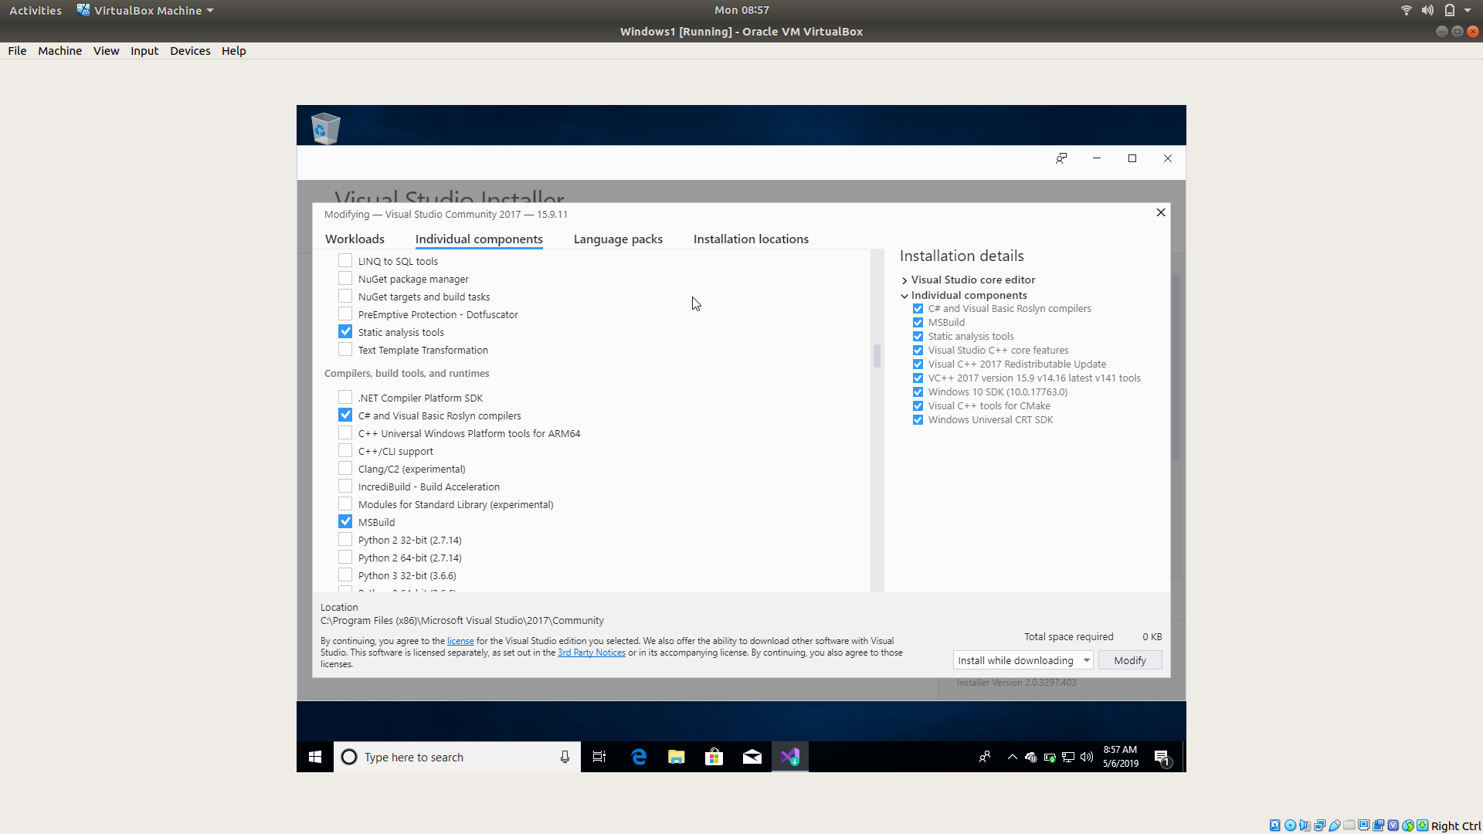

Slide 5
QT Maintenance Tool
Although I have selected MSVC 2015 & MSVC 2017- 32 bit, you need not select them
Only MSVC 2017 64 bit will do

Slide 6
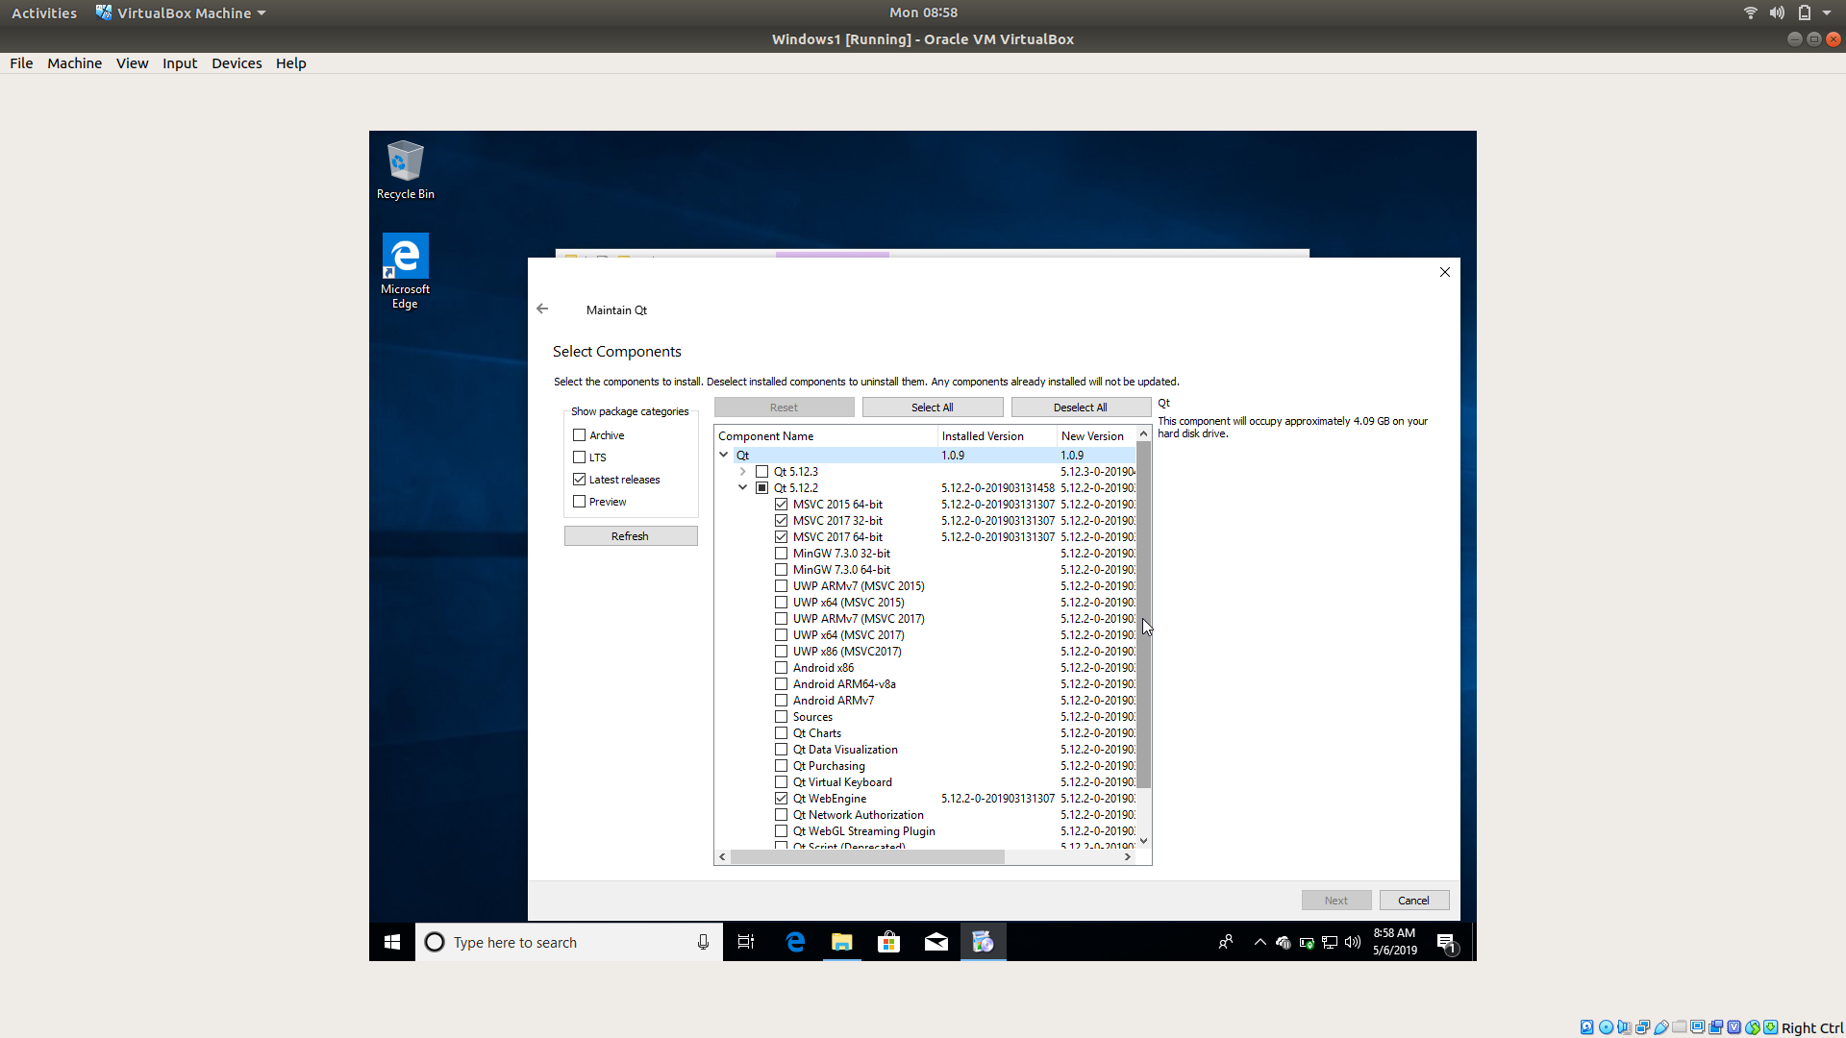

Slide 7
QT Manage Kits
Restart QT
Go to Manage Kits and select the compiler as shown below
Import the project and run

Slide 8
